Slide 1

COURSE SLIDES
Claude Microsoft 365 Masterclass (C197)
Course Code: C197
Conducted by Tertiary Infotech Academy Pte Ltd · UEN 201200696W
Version v3.0 · 13 August 2026
© 2026 Tertiary Infotech Academy Pte Ltd. All rights reserved. · www.tertiarycourses.com.sg

Slide 2
LEARNER LMS ACCESS
Download Your Course Materials
Use OTP to sign in
1
Enter the email address registered for your course.
LEARNER PORTAL
Sign in to access the course deck, Learner Guide and activity files.
2
Choose OTP sign-in and request a code. Check your registered email.
tertiarycourses.com.sg/lmslogin
3
Enter the OTP, open C197 and download your materials.
OPEN LEARNER LOGIN
Cannot receive the OTP? Use password sign-in
Click the button or type the web address above.
Same registered email · Password: student12345
Claude Microsoft 365 Masterclass (C197) · C197
© 2026 Tertiary Infotech Academy Pte Ltd
1

Slide 3
COURSE ADMINISTRATION
Welcome & Housekeeping
Claude Microsoft 365 Masterclass (C197) · C197
© 2026 Tertiary Infotech Academy Pte Ltd
2

Slide 4
YOUR TRAINER · GENERAL
About the Trainer
NAME
____________________________________________
?
TITLE / DESIGNATION
____________________________________________
QUALIFICATIONS
____________________________________________
Your Trainer
AREAS OF EXPERTISE
____________________________________________
General Trainer template — to be completed by the trainer
TRAINING & INDUSTRY EXPERIENCE
____________________________________________
CONTACT
____________________________________________
Claude Microsoft 365 Masterclass (C197) · C197
© 2026 Tertiary Infotech Academy Pte Ltd
3

Slide 5
YOUR TRAINER
About the Trainer
ROLE
Principal Trainer, Tertiary Infotech Academy Pte. Ltd.
AA
BACKGROUND
PhD — 20+ years of industry and training experience in data, analytics and applied AI.
Dr. Alfred Ang
DELIVERS
Professional short courses for Tertiary Infotech Academy.
Principal Trainer Tertiary Infotech Academy Pte. Ltd.
FOUNDER
Founder and lead instructor at Tertiary Infotech / Tertiary Courses.
Claude Microsoft 365 Masterclass (C197) · C197
© 2026 Tertiary Infotech Academy Pte Ltd
4

Slide 6
ICE-BREAKER
Let's Know Each Other
Your name and organisation / role.
1
Your experience with this subject (if any).
2
What you want to be able to do after this course.
3
Claude Microsoft 365 Masterclass (C197) · C197
© 2026 Tertiary Infotech Academy Pte Ltd
5

Slide 7
HOUSEKEEPING
Ground Rules
Set your mobile phone to silent mode.
Participate actively — no question is too small.
1
2
Mutual respect: agree to disagree.
One conversation at a time.
3
4
Be punctual; return from breaks on time.
Learn by doing — try every hands-on lab.
5
6
Claude Microsoft 365 Masterclass (C197) · C197
© 2026 Tertiary Infotech Academy Pte Ltd
6

Slide 8
COURSE RESOURCES
Your Connected Course Workspace
Visual course deck
Concepts, process maps, prompt anatomy and realistic Office exhibits.
Detailed Learner Guide
Click-level procedures, full prompts, commands, checks and troubleshooting.
1
2
Eleven lab folders
A connected Lumina Living workflow with a README in every activity folder.
Native Office artifacts
Editable Word, Excel and PowerPoint samples plus reusable review templates.
3
4
Learner login: https://www.tertiarycourses.com.sg/lmslogin
Claude Microsoft 365 Masterclass (C197) · C197
© 2026 Tertiary Infotech Academy Pte Ltd
7

Slide 9
SCHEDULE
Lesson Plan — One Connected Company Day
Morning
Afternoon
• Morning · 9:30am–1:10pm
– Topic 1: Getting Claude Ready for HR Work (Labs 0–3)
– Topic 2: Hiring Plans, Policies and Staff Documents (Labs 4–5)
• Afternoon · 2:10pm–6:30pm
– Topic 3: People Numbers and Reporting to Leadership (Labs 6–7)
– Topic 4: Staff Questions, Repeatable Work and Advanced Claude (Labs 8–15)
• Daily timing
– 8 scheduled hours excluding lunch · 7.5 instructional hours · two tea breaks
Claude Microsoft 365 Masterclass (C197) · C197
© 2026 Tertiary Infotech Academy Pte Ltd
8

Slide 10
WHAT YOU'LL ACHIEVE
Learning Outcomes
Pick the right place
Choose the right place to use Claude for an HR task.
Decide what Claude reads
Decide what staff information Claude may read, and what it must never change.
1
2
Ask clearly
Write a request that says what you want, what to use, what to leave alone and when to stop.
Plan the hiring
Write a hiring plan in Word using only what the brief actually says.
3
4
Check the policy wording
Draft leave and flexible-work policy wording that flags every point needing legal review.
5
Claude Microsoft 365 Masterclass (C197) · C197
© 2026 Tertiary Infotech Academy Pte Ltd
9

Slide 11
WHAT YOU'LL ACHIEVE
Learning Outcomes (cont.)
People numbers
Build a headcount and turnover analysis in Excel using live formulas.
Tell leadership
Build a leadership update deck where every slide title states a conclusion.
6
7
Handle the inbox
Sort the HR inbox and draft one reply ready for approval.
One folder, one summary
Have Claude read one folder and write a people summary that says where each fact came from.
8
9
Automate the update
Automate a weekly people update on your own computer.
10
Claude Microsoft 365 Masterclass (C197) · C197
© 2026 Tertiary Infotech Academy Pte Ltd
10

Slide 12
WHAT YOU'LL ACHIEVE
Learning Outcomes (cont.)
Save it as a Skill
Save a working method as a Skill so the whole team applies the same standard.
Connect SharePoint
Use the Microsoft 365 connector to find HR files stored in SharePoint.
11
12
Add a plugin
Add a plugin, and judge when a task needs one and when it does not.
13
Claude Microsoft 365 Masterclass (C197) · C197
© 2026 Tertiary Infotech Academy Pte Ltd
11

Slide 13
LEARNING APPROACH
How You'll Learn
1
2
3
4
5
▶
▶
▶
▶
Trainer demonstrates the concept
You build it yourself in the hands-on lab
Verify with the lab's 'Test it' step
Discuss and troubleshoot together
Recap against the learning outcomes
Claude Microsoft 365 Masterclass (C197) · C197
© 2026 Tertiary Infotech Academy Pte Ltd
12

Slide 14
CORE CONCEPTS
The Lumina Living Management Challenge
Claude Microsoft 365 Masterclass (C197) · C197
© 2026 Tertiary Infotech Academy Pte Ltd
13

Slide 15
OVERVIEW
One Company, One Connected Evidence Chain
Plan the year — turn the company's hiring needs into a plan, staff policies and clear approvals.
Work the numbers — check headcount, staff cost and budget assumptions in an Excel workbook you can follow.
1
2
Communicate the decision — build a company-standard executive deck using verified Word and Excel content.
Coordinate the work — triage Outlook, use Cowork for multi-file execution and use Claude Code for a repeatable daily brief.
3
4
Claude Microsoft 365 Masterclass (C197) · C197
© 2026 Tertiary Infotech Academy Pte Ltd
14

Slide 16
THE BUILDING BLOCKS
The FRAME Control Loop
Frame
Name the decision, audience, permitted sources and definition of done.
Retrieve
Bring only authorised files, messages and ranges into context.
1
2
Act
Ask Claude to draft or edit the smallest useful unit in the native work product.
Measure
Verify figures, claims, formulas, formatting and policy constraints.
3
4
Endorse
Record assumptions and obtain the named human approval before save, send or release.
5
Claude Microsoft 365 Masterclass (C197) · C197
© 2026 Tertiary Infotech Academy Pte Ltd
15

Slide 17
THE PROFESSIONAL STANDARD
From Polished Output to Trusted Work
A polished output is not a trusted output until its evidence, logic and owner are visible.
1
2
3
4
EVIDENCE
LOGIC
OWNERSHIP
HAND-OFF
Claims trace to a file, heading, cell, range or approved message.
Formulas, assumptions and recommendations remain visible and challengeable.
A named reviewer accepts the business decision and unresolved risk.
The presentation teaches the business architecture. The Learner Guide and lab folders contain the exact prompts, commands, source files and review checks.
Claude Microsoft 365 Masterclass (C197) · C197
© 2026 Tertiary Infotech Academy Pte Ltd
16

Slide 18
COURSE ROADMAP
The Company Pack You Will Build
Plans and policies
Analysis and story
Agentic coordination
• Hiring plan
• One-page people plan
• Leave and flexible-work drafts
• Headcount analysis
• People numbers
• Leadership update deck
• Outlook draft workflow
• Cowork project
• Claude Code daily brief
Claude Microsoft 365 Masterclass (C197) · C197
© 2026 Tertiary Infotech Academy Pte Ltd
17

Slide 19
THE LEARNING ARC
How Every Activity Connects
Open the lab folder and inspect its realistic Word, Excel and PowerPoint company artifacts.
Use the named evidence and prompt contract to create or improve a work product.
1
2
Challenge the result against formulas, sources, policy boundaries and company templates.
Record the approval, retain the verified artifact and pass only approved context to the next activity.
3
4
Claude Microsoft 365 Masterclass (C197) · C197
© 2026 Tertiary Infotech Academy Pte Ltd
18

Slide 20
PROMPTING FOR OFFICE WORK
Prompts That Produce Reviewable Work
Word · Excel · PowerPoint · evidence · constraints · approval
Claude Microsoft 365 Masterclass (C197) · C197
© 2026 Tertiary Infotech Academy Pte Ltd
19

Slide 21
BUSINESS RESULT TO APPROVAL GATE
The Five-Part Prompt Contract
Name the business result
State the decision, audience and artifact—not merely the app you are using.
Ground the work
Name the open file, table, sheet, section or approved message set Claude may use.
1
2
Constrain the edit
Define scope, length, style, formula method, layout and anything Claude must not change.
Demand evidence
Require cell, range, heading or email citations and ask Claude to flag missing information.
3
4
Set the approval gate
Ask for proposed changes first; verify them before accepting, saving, sending or publishing.
5
Claude Microsoft 365 Masterclass (C197) · C197
© 2026 Tertiary Infotech Academy Pte Ltd
20

Slide 22
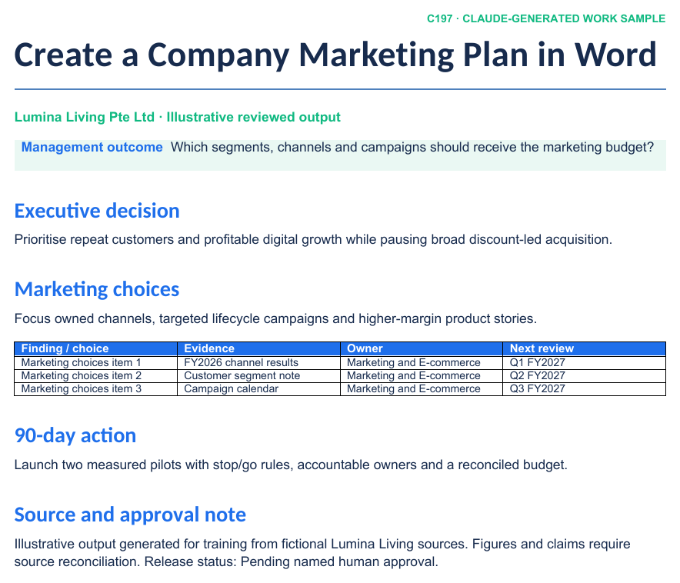
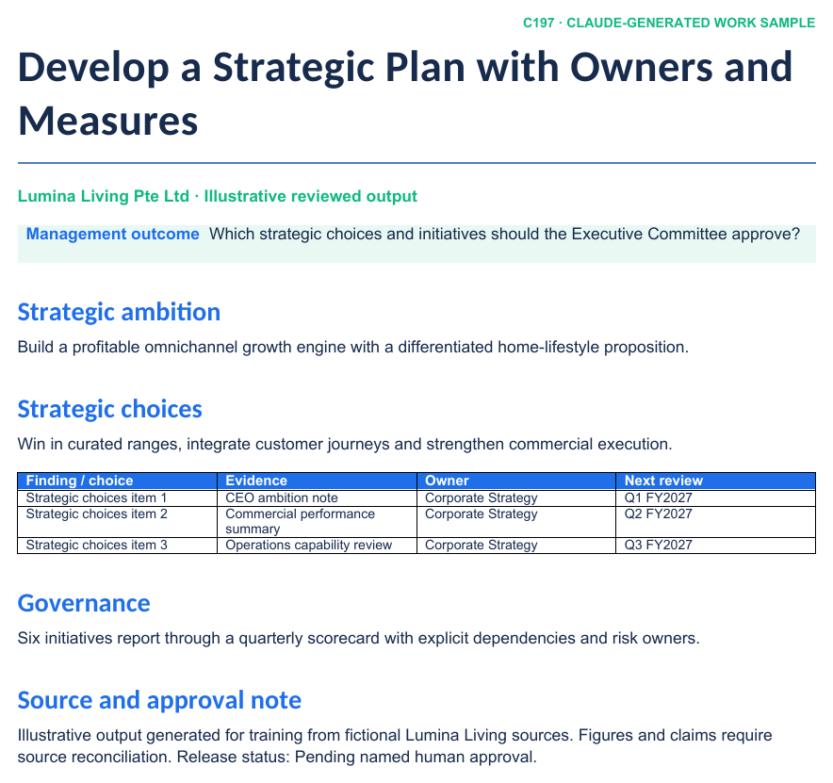
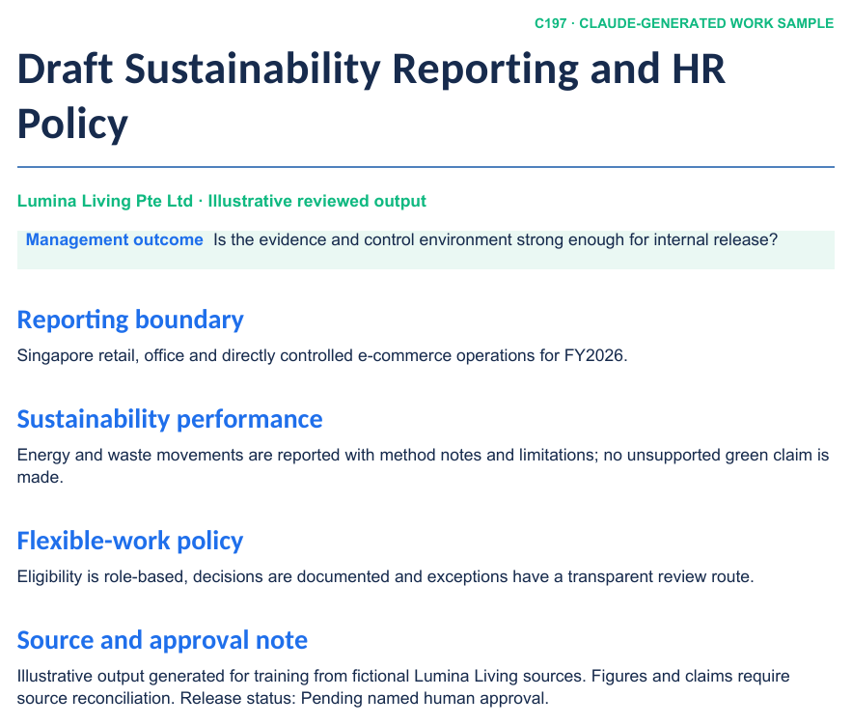
REALISTIC COMPANY WORK
Claude-Generated Planning and Policy Samples
LAB 04
LAB 05
LAB 06
FY2027 Hiring Plan
One-Page People Plan
Leave and Flexible-Work Drafts
Claude Microsoft 365 Masterclass (C197) · C197
© 2026 Tertiary Infotech Academy Pte Ltd
21

Slide 23
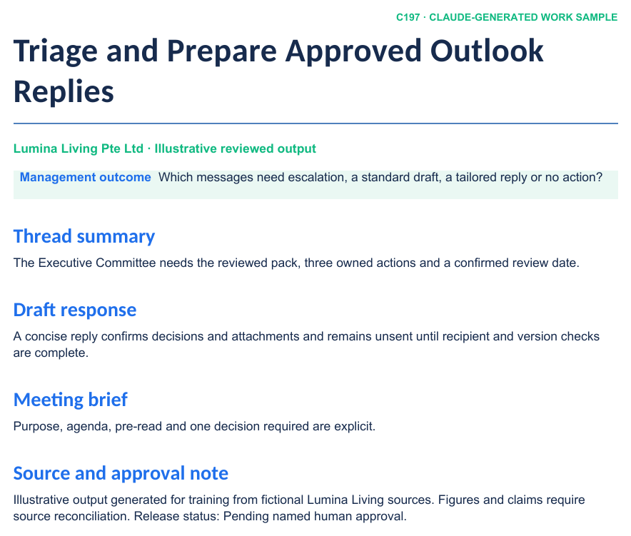
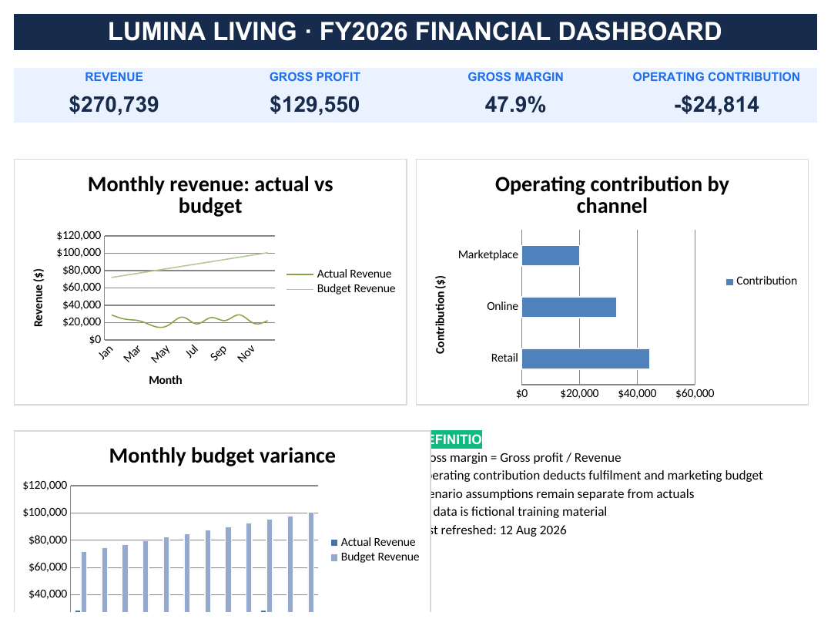
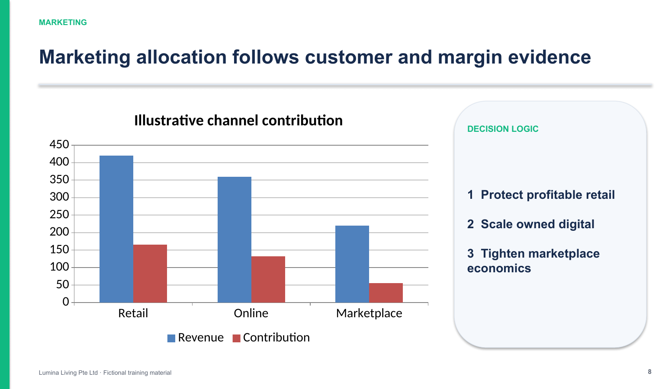
NATIVE OFFICE ARTIFACTS
Claude-Generated Analysis and Executive Samples
LAB 07
LAB 08
LAB 09
Headcount Analysis in Excel
Leadership Update Deck
Sorted HR Inbox and Draft Reply
Claude Microsoft 365 Masterclass (C197) · C197
© 2026 Tertiary Infotech Academy Pte Ltd
22

Slide 24
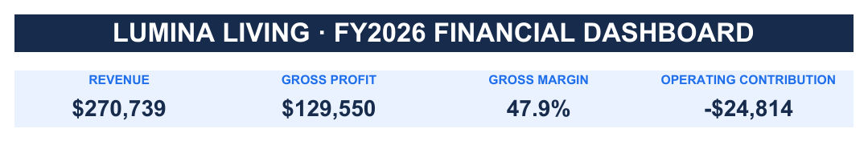
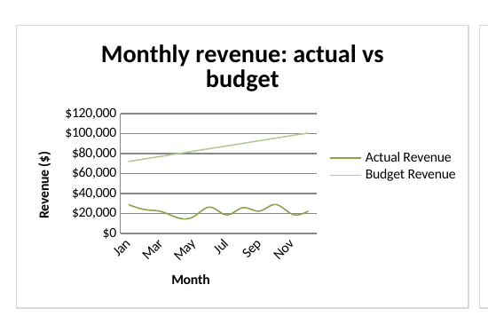
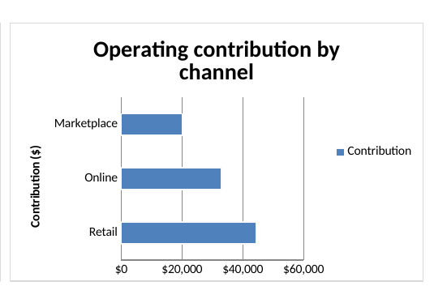
READABLE NATIVE EXCEL CHARTS
Inside the Claude-Generated Excel Dashboard
Actual vs Plan
Staff Cost by Team
Shows whether headcount is on plan and where the gap appears each month.
Separates team size from team cost so leadership can act on the right one.
Claude Microsoft 365 Masterclass (C197) · C197
© 2026 Tertiary Infotech Academy Pte Ltd
23

Slide 25
01
TOPIC 01
Getting Claude Ready for HR Work
Where to use Claude · what it may read · asking for what you want
Claude Microsoft 365 Masterclass (C197) · C197
© 2026 Tertiary Infotech Academy Pte Ltd
24

Slide 26
COURSE COVERAGE 24%
Key Concepts — Getting Claude Ready for HR Work
Three places to use Claude — inside Word, Excel and PowerPoint; in the Claude Desktop app; and in the browser. Each one sees different things.
The panel inside Office works on the file you already have open, and keeps your headings, formulas and slide layouts.
1
2
The Claude Desktop app can read a whole folder at once, so use it when the answer spans several files.
HR files hold information about real people. Decide what Claude may read, and what it must never change, before you start.
3
4
Ask Claude to say where each fact came from — which file, which sheet, which line — so you can check it before it reaches a staff member.
You decide, not Claude. Nothing is sent, published or approved until a named person says yes.
5
6
Claude Microsoft 365 Masterclass (C197) · C197
© 2026 Tertiary Infotech Academy Pte Ltd
25

Slide 27
WHAT YOU'LL DO
Hands-On Labs — Getting Claude Ready for HR Work
Labs 0–1
Labs 2–3
• Set Up Claude for Microsoft 365 — A completed setup checklist showing which of the four routes are ready, and what to do about any that are not.
• Shortlist Candidates with AI Experience — A saved shortlist in your own workbook, a second copy saved from the Desktop app, and one sentence on which way suits work that must stay in one file.
• Analyse Staff Data and Decide What Claude May Read — A summary table and chart built by Claude in your own workbook, plus a completed access table.
• Ask Claude Clearly — A new section written into the brief by Claude, a second copy produced by the Desktop app, and a completed request checklist.
Claude Microsoft 365 Masterclass (C197) · C197
© 2026 Tertiary Infotech Academy Pte Ltd
26

Slide 28
TOPIC 01 · HANDS-ON
Set Up Claude for Microsoft 365
LAB 0
Install the Claude add-in in Word, Excel and PowerPoint, sign in to Claude Desktop, connect the Microsoft 365 connector, and add Claude for Chrome. Record what works on your machine before the labs begin.
You'll build
A completed setup checklist showing which of the four routes are ready, and what to do about any that are not.
Tools: Claude for Microsoft 365 add-in, Claude Desktop, Microsoft 365 connector, Claude for Chrome
Claude Microsoft 365 Masterclass (C197) · C197
© 2026 Tertiary Infotech Academy Pte Ltd
27

Slide 29
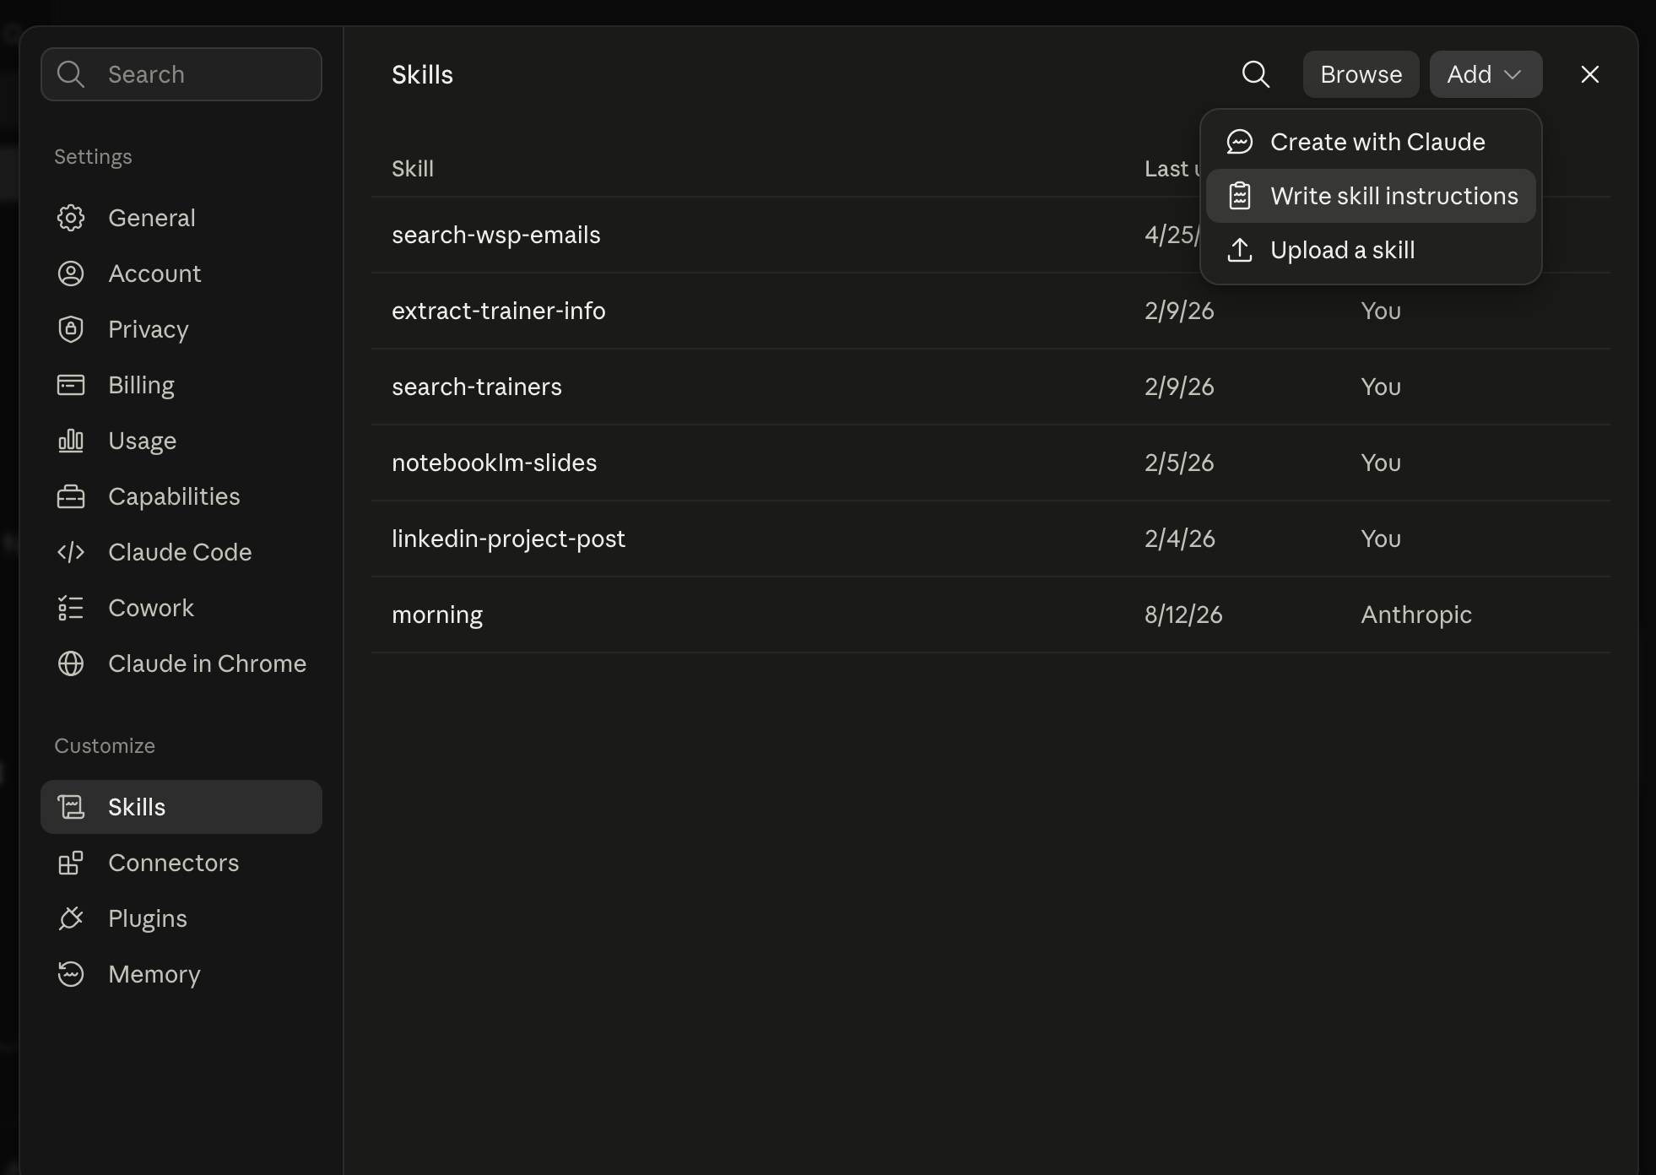
LAB 0 · SCREENSHOT
Where Skills Live
Settings > Skills on claude.ai. Add offers three ways to make one: Create with Claude, Write skill instructions, or Upload a skill.
Claude Microsoft 365 Masterclass (C197) · C197
© 2026 Tertiary Infotech Academy Pte Ltd
28

Slide 30
CONCEPT-TO-OUTCOME
Lab 0 — Process Map
1
2
3
4
5
▶
▶
▶
▶
Office add-in
Claude Desktop
Microsoft 365 connector
Claude for Chrome
Record what works
Claude Microsoft 365 Masterclass (C197) · C197
© 2026 Tertiary Infotech Academy Pte Ltd
29

Slide 31
KEY DECISIONS & CONTROLS
Lab 0 — Professional Practice
Four ways in
The Office panel, the Desktop app, the Microsoft 365 connector and the Chrome extension each see different things.
Install once
The add-in appears in Word, Excel, PowerPoint and Outlook once it is added.
1
2
The connector needs approval
It reads your Microsoft 365 content, so an administrator must enable it first.
Not available is a valid answer
Record what your account actually allows; the labs tell you the local alternative.
3
4
Claude Microsoft 365 Masterclass (C197) · C197
© 2026 Tertiary Infotech Academy Pte Ltd
30

Slide 32
LAB 0 · VERIFY
Set Up Claude for Microsoft 365
✅ ACCEPTANCE CHECK
Every row of the Setup tab has a result. The Claude panel opens in Word, Excel and PowerPoint. Claude Desktop is signed in. The Microsoft 365 connector is either connected or recorded as Needs IT approval. Claude for Chrome is installed and set to Manually approve, or recorded as unavailable.
INSPECT
RECONCILE
ENDORSE
Open the native artifact and challenge its sources, formulas, structure and versions.
Confirm every material figure or claim against the approved evidence location.
Record the named reviewer before accepting, saving, releasing or sending the work.
Claude Microsoft 365 Masterclass (C197) · C197
© 2026 Tertiary Infotech Academy Pte Ltd
31

Slide 33
TOPIC 01 · HANDS-ON
Shortlist Candidates with AI Experience
LAB 1
Twenty-four people applied for HR roles. Claude fills in the shortlist directly in your Excel sheet, you check its decisions, then you run the same request in the Claude Desktop app and see that it hands you a downloaded copy instead of editing your file.
You'll build
A saved shortlist in your own workbook, a second copy saved from the Desktop app, and one sentence on which way suits work that must stay in one file.
Tools: Claude for Word, Claude Skills, natural-language skill creation
Claude Microsoft 365 Masterclass (C197) · C197
© 2026 Tertiary Infotech Academy Pte Ltd
32

Slide 34
CONCEPT-TO-OUTCOME
Lab 1 — Process Map
1
2
3
4
5
▶
▶
▶
▶
Ask for it your way
Correct until right
Save it in one sentence
Check it is listed
Stop repeating yourself
Claude Microsoft 365 Masterclass (C197) · C197
© 2026 Tertiary Infotech Academy Pte Ltd
33

Slide 35
TRAINER AND LEARNER ROLES
Lab 1 — What You Teach
Spell it out once
The first time, say exactly how you want the work done.
Every correction is a rule
What you fix now, you never have to say again.
1
2
Saving is a sentence
'Save that as a skill called hr-draft.' No menu, no form.
Policy needs care
Never let Claude state a legal conclusion on your behalf.
3
4
Claude Microsoft 365 Masterclass (C197) · C197
© 2026 Tertiary Infotech Academy Pte Ltd
34

Slide 36
LAB 1 · VERIFY
Shortlist Candidates with AI Experience
✅ ACCEPTANCE CHECK
All 24 rows have Yes or No with a quoted reason and the file is saved, rows C-011 and C-013 are marked No, a second file named Lumina-Living-Lab-01-Candidates-Desktop.xlsx exists in the folder, and you have written which of the two ways keeps the shortlist in one agreed file.
INSPECT
RECONCILE
ENDORSE
Open the native artifact and challenge its sources, formulas, structure and versions.
Confirm every material figure or claim against the approved evidence location.
Record the named reviewer before accepting, saving, releasing or sending the work.
Claude Microsoft 365 Masterclass (C197) · C197
© 2026 Tertiary Infotech Academy Pte Ltd
35

Slide 37
TOPIC 01 · HANDS-ON
Analyse Staff Data and Decide What Claude May Read
LAB 2
Claude summarises the staff list by team, builds a chart, and you check its formulas. Then you decide what access Claude actually needed, having just seen what read-only access can do.
You'll build
A summary table and chart built by Claude in your own workbook, plus a completed access table.
Tools: Claude for Word, Claude Skills
Claude Microsoft 365 Masterclass (C197) · C197
© 2026 Tertiary Infotech Academy Pte Ltd
36

Slide 38
CONCEPT-TO-OUTCOME
Lab 2 — Process Map
1
2
3
4
5
▶
▶
▶
▶
New section
One short line
Same standard applied
Check it held
Repeat at will
Claude Microsoft 365 Masterclass (C197) · C197
© 2026 Tertiary Infotech Academy Pte Ltd
37

Slide 39
KEY DECISIONS & CONTROLS
Lab 2 — Professional Practice
One line is enough
The rules live in the skill, not in what you type.
The standard holds
Quality stops depending on remembering.
1
2
You still own it
A skill drafts; you check and you approve.
Compare the results
Three sections, one standard, no repetition.
3
4
Claude Microsoft 365 Masterclass (C197) · C197
© 2026 Tertiary Infotech Academy Pte Ltd
38

Slide 40
LAB 2 · VERIFY
Analyse Staff Data and Decide What Claude May Read
✅ ACCEPTANCE CHECK
The summary table uses formulas that point at the staff rows, the chart shows leaver rate by team, the file is saved, and all four places have a read-or-change decision with an owner.
INSPECT
RECONCILE
ENDORSE
Open the native artifact and challenge its sources, formulas, structure and versions.
Confirm every material figure or claim against the approved evidence location.
Record the named reviewer before accepting, saving, releasing or sending the work.
Claude Microsoft 365 Masterclass (C197) · C197
© 2026 Tertiary Infotech Academy Pte Ltd
39

Slide 41
TOPIC 01 · HANDS-ON
Ask Claude Clearly
LAB 3
Run a vague request and a clear one against the same HR brief, and see the difference for yourself.
You'll build
A new section written into the brief by Claude, a second copy produced by the Desktop app, and a completed request checklist.
Tools: Claude for Excel, Claude Skills, natural-language skill creation
Claude Microsoft 365 Masterclass (C197) · C197
© 2026 Tertiary Infotech Academy Pte Ltd
40

Slide 42
CONCEPT-TO-OUTCOME
Lab 3 — Process Map
1
2
3
4
5
▶
▶
▶
▶
Ask for it your way
Correct until right
Save it in one sentence
Check it is listed
Ready to reuse
Claude Microsoft 365 Masterclass (C197) · C197
© 2026 Tertiary Infotech Academy Pte Ltd
41

Slide 43
KEY DECISIONS & CONTROLS
Lab 3 — Professional Practice
Spell it out once
The first time, say exactly how the numbers should be worked out.
Formulas, never typed-in numbers
The rule that keeps the analysis checkable.
1
2
Saving is a sentence
'Save that as a skill called staff-numbers.'
Works beyond this file
Say so when you save, and the skill can read other workbooks too.
3
4
Claude Microsoft 365 Masterclass (C197) · C197
© 2026 Tertiary Infotech Academy Pte Ltd
42

Slide 44
LAB 3 · VERIFY
Ask Claude Clearly
✅ ACCEPTANCE CHECK
The new section sits after '3. Required management outputs' with every fact naming its heading, the file is saved, a second file named Lumina-Living-Lab-03-HR-Brief-Desktop.docx exists, and the checklist says which document you would send on and why.
INSPECT
RECONCILE
ENDORSE
Open the native artifact and challenge its sources, formulas, structure and versions.
Confirm every material figure or claim against the approved evidence location.
Record the named reviewer before accepting, saving, releasing or sending the work.
Claude Microsoft 365 Masterclass (C197) · C197
© 2026 Tertiary Infotech Academy Pte Ltd
43

Slide 45
TOPIC RECAP
Recap — Getting Claude Ready for HR Work
Capability — Install and check every way you will use Claude on this course, and record what your own account allows.
Evidence retained — A completed setup checklist showing which of the four routes are ready, and what to do about any that are not.
1
2
Capability — Use Claude to shortlist job applicants, and see the difference between the Excel panel and the Claude Desktop app.
Evidence retained — A saved shortlist in your own workbook, a second copy saved from the Desktop app, and one sentence on which way suits work that must stay in one file.
3
4
Capability — Use Claude to summarise and chart real staff data, then decide what access it needed to do that.
Evidence retained — A summary table and chart built by Claude in your own workbook, plus a completed access table.
5
6
Claude Microsoft 365 Masterclass (C197) · C197
© 2026 Tertiary Infotech Academy Pte Ltd
44

Slide 46
02
TOPIC 02
Hiring Plans, Policies and Staff Documents
Hiring plan · leave and flexible-work policy · handbook wording · who signs off
Claude Microsoft 365 Masterclass (C197) · C197
© 2026 Tertiary Infotech Academy Pte Ltd
45

Slide 47
COURSE COVERAGE 28%
Key Concepts — Hiring Plans, Policies and Staff Documents
A hiring plan makes choices: which roles now, which can wait, and what the budget will not cover.
Every role needs a hiring manager, a start date, a salary range and the reason the role exists.
1
2
Policy wording carries real consequences. Anything about pay, leave, notice or conduct needs proper review before release.
Keep three things apart: what the policy says, how it works day to day, and what needs legal advice.
3
4
Work inside the company template so the document looks like every other HR document staff receive.
Say plainly what you do not yet know, rather than filling the gap with a confident guess.
5
6
Claude Microsoft 365 Masterclass (C197) · C197
© 2026 Tertiary Infotech Academy Pte Ltd
46

Slide 48
WHAT YOU'LL DO
Hands-On Labs — Hiring Plans, Policies and Staff Documents
Lab 4
Lab 5
• Write a Hiring Plan in Word — A hiring plan section written into the brief, and a separate Lumina-Living-FY2027-Hiring-Plan.docx ready for the Head of HR.
• Build an HR Policy Skill from Your Real Policies — An hr-policy-draft skill built from your real policy library and template, and two new policies on the company letterhead.
Claude Microsoft 365 Masterclass (C197) · C197
© 2026 Tertiary Infotech Academy Pte Ltd
47

Slide 49
TOPIC 02 · HANDS-ON
Write a Hiring Plan in Word
LAB 4
Section 2 of the brief lists five roles the teams want and the budget that limits them. Claude works out what fits, writes the plan into your document, then exports it as a standalone document for approval.
You'll build
A hiring plan section written into the brief, and a separate Lumina-Living-FY2027-Hiring-Plan.docx ready for the Head of HR.
Tools: Claude for Word, company templates, evidence checks, human approval
Claude Microsoft 365 Masterclass (C197) · C197
© 2026 Tertiary Infotech Academy Pte Ltd
48

Slide 50
CONCEPT-TO-OUTCOME
Lab 4 — Process Map
1
2
3
4
5
▶
▶
▶
▶
Read the role table
Work out what fits
Write it into the brief
Check every figure
Export for approval
Claude Microsoft 365 Masterclass (C197) · C197
© 2026 Tertiary Infotech Academy Pte Ltd
49

Slide 51
KEY DECISIONS & CONTROLS
Lab 4 — Professional Practice
The budget is the constraint
Not every requested role can be filled; the plan must say which and why.
Every figure has a source
Salary bands come from the table, never from memory.
1
2
Propose before you write
Check the arithmetic in the panel before it touches the document.
Two documents, two jobs
The brief keeps the evidence; the exported plan goes for approval.
3
4
Claude Microsoft 365 Masterclass (C197) · C197
© 2026 Tertiary Infotech Academy Pte Ltd
50

Slide 52
LAB 4 · VERIFY
Write a Hiring Plan in Word
✅ ACCEPTANCE CHECK
The brief has an 'FY2027 hiring plan' section after section 3 with every salary matching the table in section 2, the total is shown against the $38,000 budget and the 10-role cap, and a separate file named Lumina-Living-FY2027-Hiring-Plan.docx exists in the folder containing only the plan.
INSPECT
RECONCILE
ENDORSE
Open the native artifact and challenge its sources, formulas, structure and versions.
Confirm every material figure or claim against the approved evidence location.
Record the named reviewer before accepting, saving, releasing or sending the work.
Claude Microsoft 365 Masterclass (C197) · C197
© 2026 Tertiary Infotech Academy Pte Ltd
51

Slide 53
TOPIC 02 · HANDS-ON
Build an HR Policy Skill from Your Real Policies
LAB 5
Your house style already exists in the policies you have published and the template you write them into. Hand Claude the examples, the rules and the template, turn that into a skill, then draft two new policies from a real consultation note.
You'll build
An hr-policy-draft skill built from your real policy library and template, and two new policies on the company letterhead.
Tools: Claude Skills, Upload a skill, Claude for Word
Claude Microsoft 365 Masterclass (C197) · C197
© 2026 Tertiary Infotech Academy Pte Ltd
52

Slide 54
LAB 5 · SCREENSHOT
Creating the HR Policy Skill
Settings > Skills > Add. Lab 5 uses Create with Claude, handing it the policy library and the written standard.
Claude Microsoft 365 Masterclass (C197) · C197
© 2026 Tertiary Infotech Academy Pte Ltd
53

Slide 55
CONCEPT-TO-OUTCOME
Lab 5 — Process Map
1
2
3
4
5
▶
▶
▶
▶
Define boundary
Verify metrics
Draft narrative
Separate policy from procedure
Obtain specialist approval
Claude Microsoft 365 Masterclass (C197) · C197
© 2026 Tertiary Infotech Academy Pte Ltd
54

Slide 56
KEY DECISIONS & CONTROLS
Lab 5 — Professional Practice
Boundary before narrative
State entities, sites, period, method and exclusions before describing performance.
Numbers need lineage
Every metric names the source system, owner, unit, method and limitation.
1
2
Policy is not legal advice
AI drafts require authorised HR and legal review before organisational release.
Exceptions are designed
Eligibility, decision rights, escalation and record keeping prevent an attractive policy from becoming unusable.
3
4
Claude Microsoft 365 Masterclass (C197) · C197
© 2026 Tertiary Infotech Academy Pte Ltd
55

Slide 57
LAB 5 · VERIFY
Build an HR Policy Skill from Your Real Policies
✅ ACCEPTANCE CHECK
A skill named hr-policy-draft is listed in Settings > Skills, both new policies use the company letterhead and the four numbered sections, every fact traces to the consultation note, every open point from the note appears under 'Still to confirm', no legal conclusion is stated, the approval table is intact, and both files are saved in the lab folder.
INSPECT
RECONCILE
ENDORSE
Open the native artifact and challenge its sources, formulas, structure and versions.
Confirm every material figure or claim against the approved evidence location.
Record the named reviewer before accepting, saving, releasing or sending the work.
Claude Microsoft 365 Masterclass (C197) · C197
© 2026 Tertiary Infotech Academy Pte Ltd
56

Slide 58
TOPIC RECAP
Recap — Hiring Plans, Policies and Staff Documents
Capability — Write an FY2027 hiring plan in Word using only what the HR brief actually says.
Evidence retained — A hiring plan section written into the brief, and a separate Lumina-Living-FY2027-Hiring-Plan.docx ready for the Head of HR.
1
2
Capability — Create a skill from your company's existing policy documents, then use it to draft new policy wording that matches them.
Evidence retained — An hr-policy-draft skill built from your real policy library and template, and two new policies on the company letterhead.
3
4
Claude Microsoft 365 Masterclass (C197) · C197
© 2026 Tertiary Infotech Academy Pte Ltd
57

Slide 59
03
TOPIC 03
People Numbers and Reporting to Leadership
Headcount and turnover in Excel · what the numbers say · the leadership update
Claude Microsoft 365 Masterclass (C197) · C197
© 2026 Tertiary Infotech Academy Pte Ltd
58

Slide 60
COURSE COVERAGE 25%
Key Concepts — People Numbers and Reporting to Leadership
Keep the staff data, the assumptions and the results on separate sheets so anyone can follow the working.
Use live formulas that point at the source data. A number typed in by hand cannot be checked or updated.
1
2
Compare actual headcount and cost against plan, month by month and team by team, before you explain the result.
Pick the chart that answers the question leadership asked. More charts is not more insight.
3
4
Every slide title should say what you concluded, not name a topic.
Put the source under any figure on a slide, so the room can challenge it.
5
6
Claude Microsoft 365 Masterclass (C197) · C197
© 2026 Tertiary Infotech Academy Pte Ltd
59

Slide 61
WHAT YOU'LL DO
Hands-On Labs — People Numbers and Reporting to Leadership
Lab 6
Lab 7
• Build a Headcount Analysis in Excel — An analysis sheet where every result is a formula that points back to the source data.
• Build a Leadership Deck Two Ways — Two versions of the same six-slide update: one built in the panel with a linked Excel chart, one built end to end by Claude Desktop.
Claude Microsoft 365 Masterclass (C197) · C197
© 2026 Tertiary Infotech Academy Pte Ltd
60

Slide 62
TOPIC 03 · HANDS-ON
Build a Headcount Analysis in Excel
LAB 6
Compare actual headcount and staff cost against plan, month by month and team by team, using formulas that point at the source data.
You'll build
An analysis sheet where every result is a formula that points back to the source data.
Tools: Claude for Excel, tables, formulas, pivots, scenarios, chart selection, dashboard, audit log
Claude Microsoft 365 Masterclass (C197) · C197
© 2026 Tertiary Infotech Academy Pte Ltd
61

Slide 63
CONCEPT-TO-OUTCOME
Lab 6 — Process Map
1
2
3
4
5
▶
▶
▶
▶
Understand the model
Validate inputs
Build formulas
Explain drivers
Dashboard and senior review
Claude Microsoft 365 Masterclass (C197) · C197
© 2026 Tertiary Infotech Academy Pte Ltd
62

Slide 64
KEY DECISIONS & CONTROLS
Lab 6 — Professional Practice
Model architecture
Separate Assumptions, Transactions, Budget, Analysis, Dashboard and Audit Log.
No pasted answers
Keep calculations live in formulas or pivots and cite the source range.
1
2
Charts answer decisions
Use trend, variance and driver visuals with honest scales and units.
Review like a finance leader
Challenge timing, hardcodes, range gaps, margin logic and scenario sensitivity.
3
4
Claude Microsoft 365 Masterclass (C197) · C197
© 2026 Tertiary Infotech Academy Pte Ltd
63

Slide 65
LAB 6 · VERIFY
Build a Headcount Analysis in Excel
✅ ACCEPTANCE CHECK
Two result cells checked in the formula bar show real formulas pointing at the source data, and changing an assumption updates the analysis.
INSPECT
RECONCILE
ENDORSE
Open the native artifact and challenge its sources, formulas, structure and versions.
Confirm every material figure or claim against the approved evidence location.
Record the named reviewer before accepting, saving, releasing or sending the work.
Claude Microsoft 365 Masterclass (C197) · C197
© 2026 Tertiary Infotech Academy Pte Ltd
64

Slide 66
TOPIC 03 · HANDS-ON
Build a Leadership Deck Two Ways
LAB 7
Start from a blank deck. Build it with the Office panel, pasting the chart yourself so it stays linked to Excel. Then have Claude Desktop build the whole thing unaided, and compare what each produced.
You'll build
Two versions of the same six-slide update: one built in the panel with a linked Excel chart, one built end to end by Claude Desktop.
Tools: Claude for PowerPoint, Claude for Excel, Claude Desktop, linked native charts
Claude Microsoft 365 Masterclass (C197) · C197
© 2026 Tertiary Infotech Academy Pte Ltd
65

Slide 67
CONCEPT-TO-OUTCOME
Lab 7 — Process Map
1
2
3
4
5
▶
▶
▶
▶
Get the headline in Excel
Plan the six slides
Panel builds, you paste the chart
Desktop builds the whole deck
Compare and refine
Claude Microsoft 365 Masterclass (C197) · C197
© 2026 Tertiary Infotech Academy Pte Ltd
66

Slide 68
KEY DECISIONS & CONTROLS
Lab 7 — Professional Practice
Panel: one file at a time
It edits the deck you have open, so you paste the chart yourself — and it stays linked.
Desktop: reads the folder
It sees Excel and Word together and produces a finished file, but not into your open deck.
1
2
Linked beats pasted picture
A linked chart updates when the numbers change; a picture does not.
Keep prompting
Neither method is one-shot. Split a slide, sharpen a title, add a closing ask.
3
4
Claude Microsoft 365 Masterclass (C197) · C197
© 2026 Tertiary Infotech Academy Pte Ltd
67

Slide 69
LAB 7 · VERIFY
Build a Leadership Deck Two Ways
✅ ACCEPTANCE CHECK
Both decks exist: one built in the panel with the Excel chart pasted in and linked, one named Lumina-Living-Q1-Update-Desktop.pptx built by Claude Desktop. Every title states a conclusion, every figure has a source note, you have written which version keeps the chart linked to the workbook, and at least one refinement prompt was used after the first build.
INSPECT
RECONCILE
ENDORSE
Open the native artifact and challenge its sources, formulas, structure and versions.
Confirm every material figure or claim against the approved evidence location.
Record the named reviewer before accepting, saving, releasing or sending the work.
Claude Microsoft 365 Masterclass (C197) · C197
© 2026 Tertiary Infotech Academy Pte Ltd
68

Slide 70
TOPIC RECAP
Recap — People Numbers and Reporting to Leadership
Capability — Build a headcount and cost analysis in Excel using live formulas, not typed-in numbers.
Evidence retained — An analysis sheet where every result is a formula that points back to the source data.
1
2
Capability — Build the same deck twice — once with the PowerPoint panel and a pasted Excel chart, once with Claude Desktop reading both files — and judge which suits the job.
Evidence retained — Two versions of the same six-slide update: one built in the panel with a linked Excel chart, one built end to end by Claude Desktop.
3
4
Claude Microsoft 365 Masterclass (C197) · C197
© 2026 Tertiary Infotech Academy Pte Ltd
69

Slide 71
04
TOPIC 04
Staff Questions, Repeatable Work and Advanced Claude
Sorting the HR inbox · one folder, one summary · the weekly update · Skills, connectors and plugins
Claude Microsoft 365 Masterclass (C197) · C197
© 2026 Tertiary Infotech Academy Pte Ltd
70

Slide 72
COURSE COVERAGE 23%
Key Concepts — Staff Questions, Repeatable Work and Advanced Claude
Sort staff messages by what each one needs: a reply from you, a decision from someone else, or nothing at all.
Claude drafts the reply; you check the facts, the tone and the recipient, and you are the one who sends it.
1
2
Point Claude Desktop at one folder and it can pull a summary together from everything inside it.
When two files disagree, that disagreement is the finding. It is not Claude's job to settle it quietly.
3
4
Work you repeat every week is worth automating once, with a backup taken before anything is overwritten.
An automated update still needs a person to read it before it goes to anyone else.
5
6
Claude Microsoft 365 Masterclass (C197) · C197
© 2026 Tertiary Infotech Academy Pte Ltd
71

Slide 73
WHAT YOU'LL DO
Hands-On Labs — Staff Questions, Repeatable Work and Advanced Claude
Labs 8–9, 15
Labs 10–12
Labs 13–14
• Use the Skill from Word Without Opening Excel — A completed quarterly update with figures drawn from the workbook, saved as a final copy.
• Sort the HR Inbox and Draft One Reply — Every message sorted, one reply drafted, the person who would approve it named, and the reply created as an Outlook draft ready for review.
• Read a Whole Folder and Write the Summary — A two-page people summary built only from the folder, naming the file behind every claim, with disagreements reported rather than settled.
• Build a Daily HR Routine with Cowork — A written daily routine covering inbox, reporting and chasing; this week's work assigned an owner and a deadline; and today's daily HR report.
• Automate an HR Pipeline with a Project — A Lumina Living HR project with materials and standing instructions, and a new starter pipeline run twice from it.
• Draft an Outlook Reply with Claude in Chrome — A reviewed reply drafted in Outlook on the web, sent only after you approved it or deliberately left in Drafts.
• Add Skills and Connectors to the Project — An HR project with materials, standing rules, a skill and a connector, running one request that produces a policy draft, a summary and an Outlook draft.
• Upload a Shared Skill for Slides — An uploaded deck-design-standard skill, and a rebuilt deck where every title states a conclusion.
Claude Microsoft 365 Masterclass (C197) · C197
© 2026 Tertiary Infotech Academy Pte Ltd
72

Slide 74
TOPIC 04 · HANDS-ON
Use the Skill from Word Without Opening Excel
LAB 15
The quarterly update is due and the figures are in a workbook. One short line, and the skill reads the workbook, works the numbers out your way, and writes them into the update.
You'll build
A completed quarterly update with figures drawn from the workbook, saved as a final copy.
Tools: Claude Skills, Claude Desktop, Word, Excel
Claude Microsoft 365 Masterclass (C197) · C197
© 2026 Tertiary Infotech Academy Pte Ltd
73

Slide 75
CONCEPT-TO-OUTCOME
Lab 15 — Process Map
1
2
3
4
5
▶
▶
▶
▶
Figures in one file, words in another
Desktop can see both
One short line
Check the figures
Save the final copy
Claude Microsoft 365 Masterclass (C197) · C197
© 2026 Tertiary Infotech Academy Pte Ltd
74

Slide 76
KEY DECISIONS & CONTROLS
Lab 15 — Professional Practice
Across two apps
The skill reads Excel and writes Word without you switching.
Panel versus Desktop
The Office panel sees one open file; Desktop sees the folder.
1
2
One line is enough
Every rule lives in the skill, not in what you type.
Desktop hands you a copy
It does not edit your open file — save the copy deliberately.
3
4
Claude Microsoft 365 Masterclass (C197) · C197
© 2026 Tertiary Infotech Academy Pte Ltd
75

Slide 77
LAB 15 · VERIFY
Use the Skill from Word Without Opening Excel
✅ ACCEPTANCE CHECK
The update contains totals by team and the leaver rate to one decimal place, the worst team is named and explained, two figures were checked against the workbook by hand, and a file named Lumina-Living-Q1-Update-Final.docx exists in the folder.
INSPECT
RECONCILE
ENDORSE
Open the native artifact and challenge its sources, formulas, structure and versions.
Confirm every material figure or claim against the approved evidence location.
Record the named reviewer before accepting, saving, releasing or sending the work.
Claude Microsoft 365 Masterclass (C197) · C197
© 2026 Tertiary Infotech Academy Pte Ltd
76

Slide 78
TOPIC 04 · HANDS-ON
Sort the HR Inbox and Draft One Reply
LAB 8
Work through a set of fictional staff messages held in a local workbook. Claude sorts them by what each one needs and drafts one reply. Then the Microsoft 365 connector turns that reply into a real Outlook draft — which you review and send yourself.
You'll build
Every message sorted, one reply drafted, the person who would approve it named, and the reply created as an Outlook draft ready for review.
Tools: Claude for Outlook beta, Outlook categories, thread citations, reply templates, calendar, approval queue
Claude Microsoft 365 Masterclass (C197) · C197
© 2026 Tertiary Infotech Academy Pte Ltd
77

Slide 79
CONCEPT-TO-OUTCOME
Lab 8 — Process Map
1
2
3
4
5
▶
▶
▶
▶
Classify
Summarise with citations
Select approved template
Draft in native form
Review recipients and send
Claude Microsoft 365 Masterclass (C197) · C197
© 2026 Tertiary Infotech Academy Pte Ltd
78

Slide 80
KEY DECISIONS & CONTROLS
Lab 8 — Professional Practice
Rules before generation
Define category, priority, SLA, reply eligibility and escalation before asking Claude to draft.
Thread evidence
Capture decisions, owners and deadlines with citations to the specific message.
1
2
Auto-draft, not auto-send
Claude for Outlook leaves drafts and invitations in Outlook for the authorised user.
Consequential details
Recipients, attachments, dates, amounts and promises receive explicit human checks.
3
4
Claude Microsoft 365 Masterclass (C197) · C197
© 2026 Tertiary Infotech Academy Pte Ltd
79

Slide 81
LAB 8 · VERIFY
Sort the HR Inbox and Draft One Reply
✅ ACCEPTANCE CHECK
Every message has an answer in the Action column, one reply under 120 words is written in the Draft_Reply column, its approver is named, and the reply exists as an unsent draft in Outlook or the connector state is recorded. Nothing was sent.
INSPECT
RECONCILE
ENDORSE
Open the native artifact and challenge its sources, formulas, structure and versions.
Confirm every material figure or claim against the approved evidence location.
Record the named reviewer before accepting, saving, releasing or sending the work.
Claude Microsoft 365 Masterclass (C197) · C197
© 2026 Tertiary Infotech Academy Pte Ltd
80

Slide 82
TOPIC 04 · HANDS-ON
Read a Whole Folder and Write the Summary
LAB 9
A quarter's worth of HR reports sits in one folder as PDFs, with a CSV of the numbers. No single file answers the question. Claude reads them all and writes one summary, naming the file behind every claim.
You'll build
A two-page people summary built only from the folder, naming the file behind every claim, with disagreements reported rather than settled.
Tools: Claude Cowork, work folder, Projects, plugins, Microsoft 365 connector, multi-step execution, approvals
Claude Microsoft 365 Masterclass (C197) · C197
© 2026 Tertiary Infotech Academy Pte Ltd
81

Slide 83
CONCEPT-TO-OUTCOME
Lab 9 — Process Map
1
2
3
4
5
▶
▶
▶
▶
Scope the folder
Connect approved context
Plan the task
Watch and steer
Review files in Microsoft 365
Claude Microsoft 365 Masterclass (C197) · C197
© 2026 Tertiary Infotech Academy Pte Ltd
82

Slide 84
KEY DECISIONS & CONTROLS
Lab 9 — Professional Practice
Bounded workspace
Give Cowork one project folder or Project, not uncontrolled access to unrelated files.
Connector supplies context
Search approved SharePoint, OneDrive, Outlook and Teams evidence through delegated permissions.
1
2
Cowork executes over steps
It can inspect inputs, create real files, update the plan and surface checkpoints.
Office add-ins finish the work
Open generated Word, Excel and PowerPoint files in the native apps for tracked review and approval.
3
4
Claude Microsoft 365 Masterclass (C197) · C197
© 2026 Tertiary Infotech Academy Pte Ltd
83

Slide 85
LAB 9 · VERIFY
Read a Whole Folder and Write the Summary
✅ ACCEPTANCE CHECK
The summary covers headcount against plan, why people are leaving and the hiring pipeline; every claim names its file; the disagreement between the headcount report and the CSV is reported with both figures; two figures were checked by hand; and the closing note says what still needs the Head of HR to confirm.
INSPECT
RECONCILE
ENDORSE
Open the native artifact and challenge its sources, formulas, structure and versions.
Confirm every material figure or claim against the approved evidence location.
Record the named reviewer before accepting, saving, releasing or sending the work.
Claude Microsoft 365 Masterclass (C197) · C197
© 2026 Tertiary Infotech Academy Pte Ltd
84

Slide 86
TOPIC 04 · HANDS-ON
Build a Daily HR Routine with Cowork
LAB 11
Ten things landed on the HR desk this week. Cowork finds what actually repeats, writes a daily routine, applies it back to the week, and produces the Monday brief. No terminal, no scripts.
You'll build
A written daily routine covering inbox, reporting and chasing; this week's work assigned an owner and a deadline; and today's daily HR report.
Tools: Claude Cowork, Claude Desktop, Excel, Word
Claude Microsoft 365 Masterclass (C197) · C197
© 2026 Tertiary Infotech Academy Pte Ltd
85

Slide 87
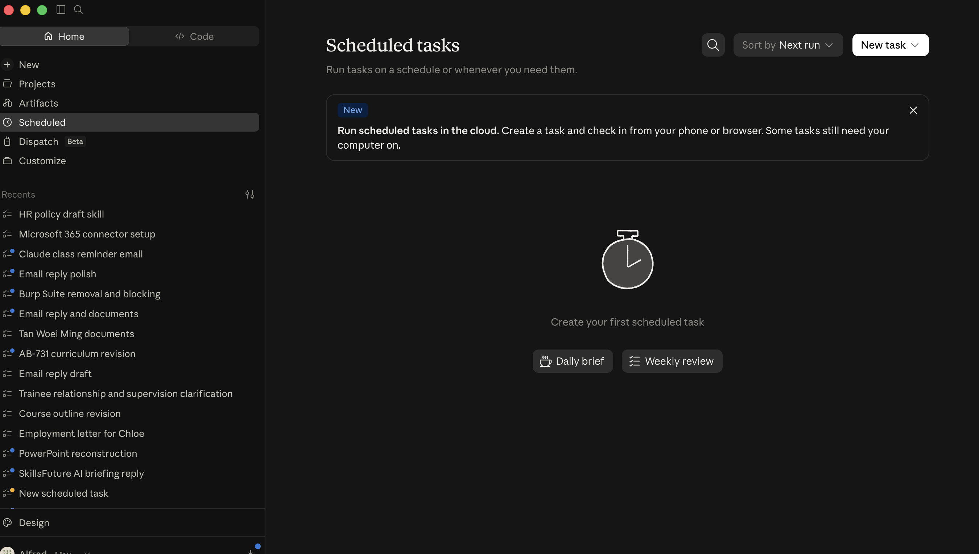
LAB 11 · SCREENSHOT
Scheduled Tasks
Claude Desktop > Scheduled. Daily brief and Weekly review are ready-made task types; New task builds your own. Delete a task when the class ends.
Claude Microsoft 365 Masterclass (C197) · C197
© 2026 Tertiary Infotech Academy Pte Ltd
86

Slide 88
CONCEPT-TO-OUTCOME
Lab 11 — Process Map
1
2
3
4
5
▶
▶
▶
▶
A week of scattered work
Find what repeats
Write the routine
Apply it to the week
Run it: today's report
Claude Microsoft 365 Masterclass (C197) · C197
© 2026 Tertiary Infotech Academy Pte Ltd
87

Slide 89
KEY DECISIONS & CONTROLS
Lab 11 — Professional Practice
Cowork works across files
Give it a folder and it moves between the workbook and the documents on its own.
Routine beats memory
Work that repeats every week should not depend on someone remembering it.
1
2
Gaps are findings
If the routine cannot place a task, that is a hole in the routine, not a mistake to paper over.
A person still reads it
The brief goes nowhere until the Head of HR has seen it.
3
4
Claude Microsoft 365 Masterclass (C197) · C197
© 2026 Tertiary Infotech Academy Pte Ltd
88

Slide 90
LAB 11 · VERIFY
Build a Daily HR Routine with Cowork
✅ ACCEPTANCE CHECK
The Daily_Routine sheet covers checking the inbox, the daily report and chasing overdue items, each with when, what, where and who. Every row of This_Week has an action, an owner and a deadline, or is marked as not covered. Lumina-Living-Daily-HR-Report.docx exists, fits one page, and names the row behind every item.
INSPECT
RECONCILE
ENDORSE
Open the native artifact and challenge its sources, formulas, structure and versions.
Confirm every material figure or claim against the approved evidence location.
Record the named reviewer before accepting, saving, releasing or sending the work.
Claude Microsoft 365 Masterclass (C197) · C197
© 2026 Tertiary Infotech Academy Pte Ltd
89

Slide 91
TOPIC 04 · HANDS-ON
Automate an HR Pipeline with a Project
LAB 12
A project keeps the policy library, the staff data and the house rules in one workspace. Set it up once, then run the new starter pipeline twice without attaching a file or restating a rule.
You'll build
A Lumina Living HR project with materials and standing instructions, and a new starter pipeline run twice from it.
Tools: Claude Projects, Claude Desktop, project instructions, uploaded materials
Claude Microsoft 365 Masterclass (C197) · C197
© 2026 Tertiary Infotech Academy Pte Ltd
90

Slide 92
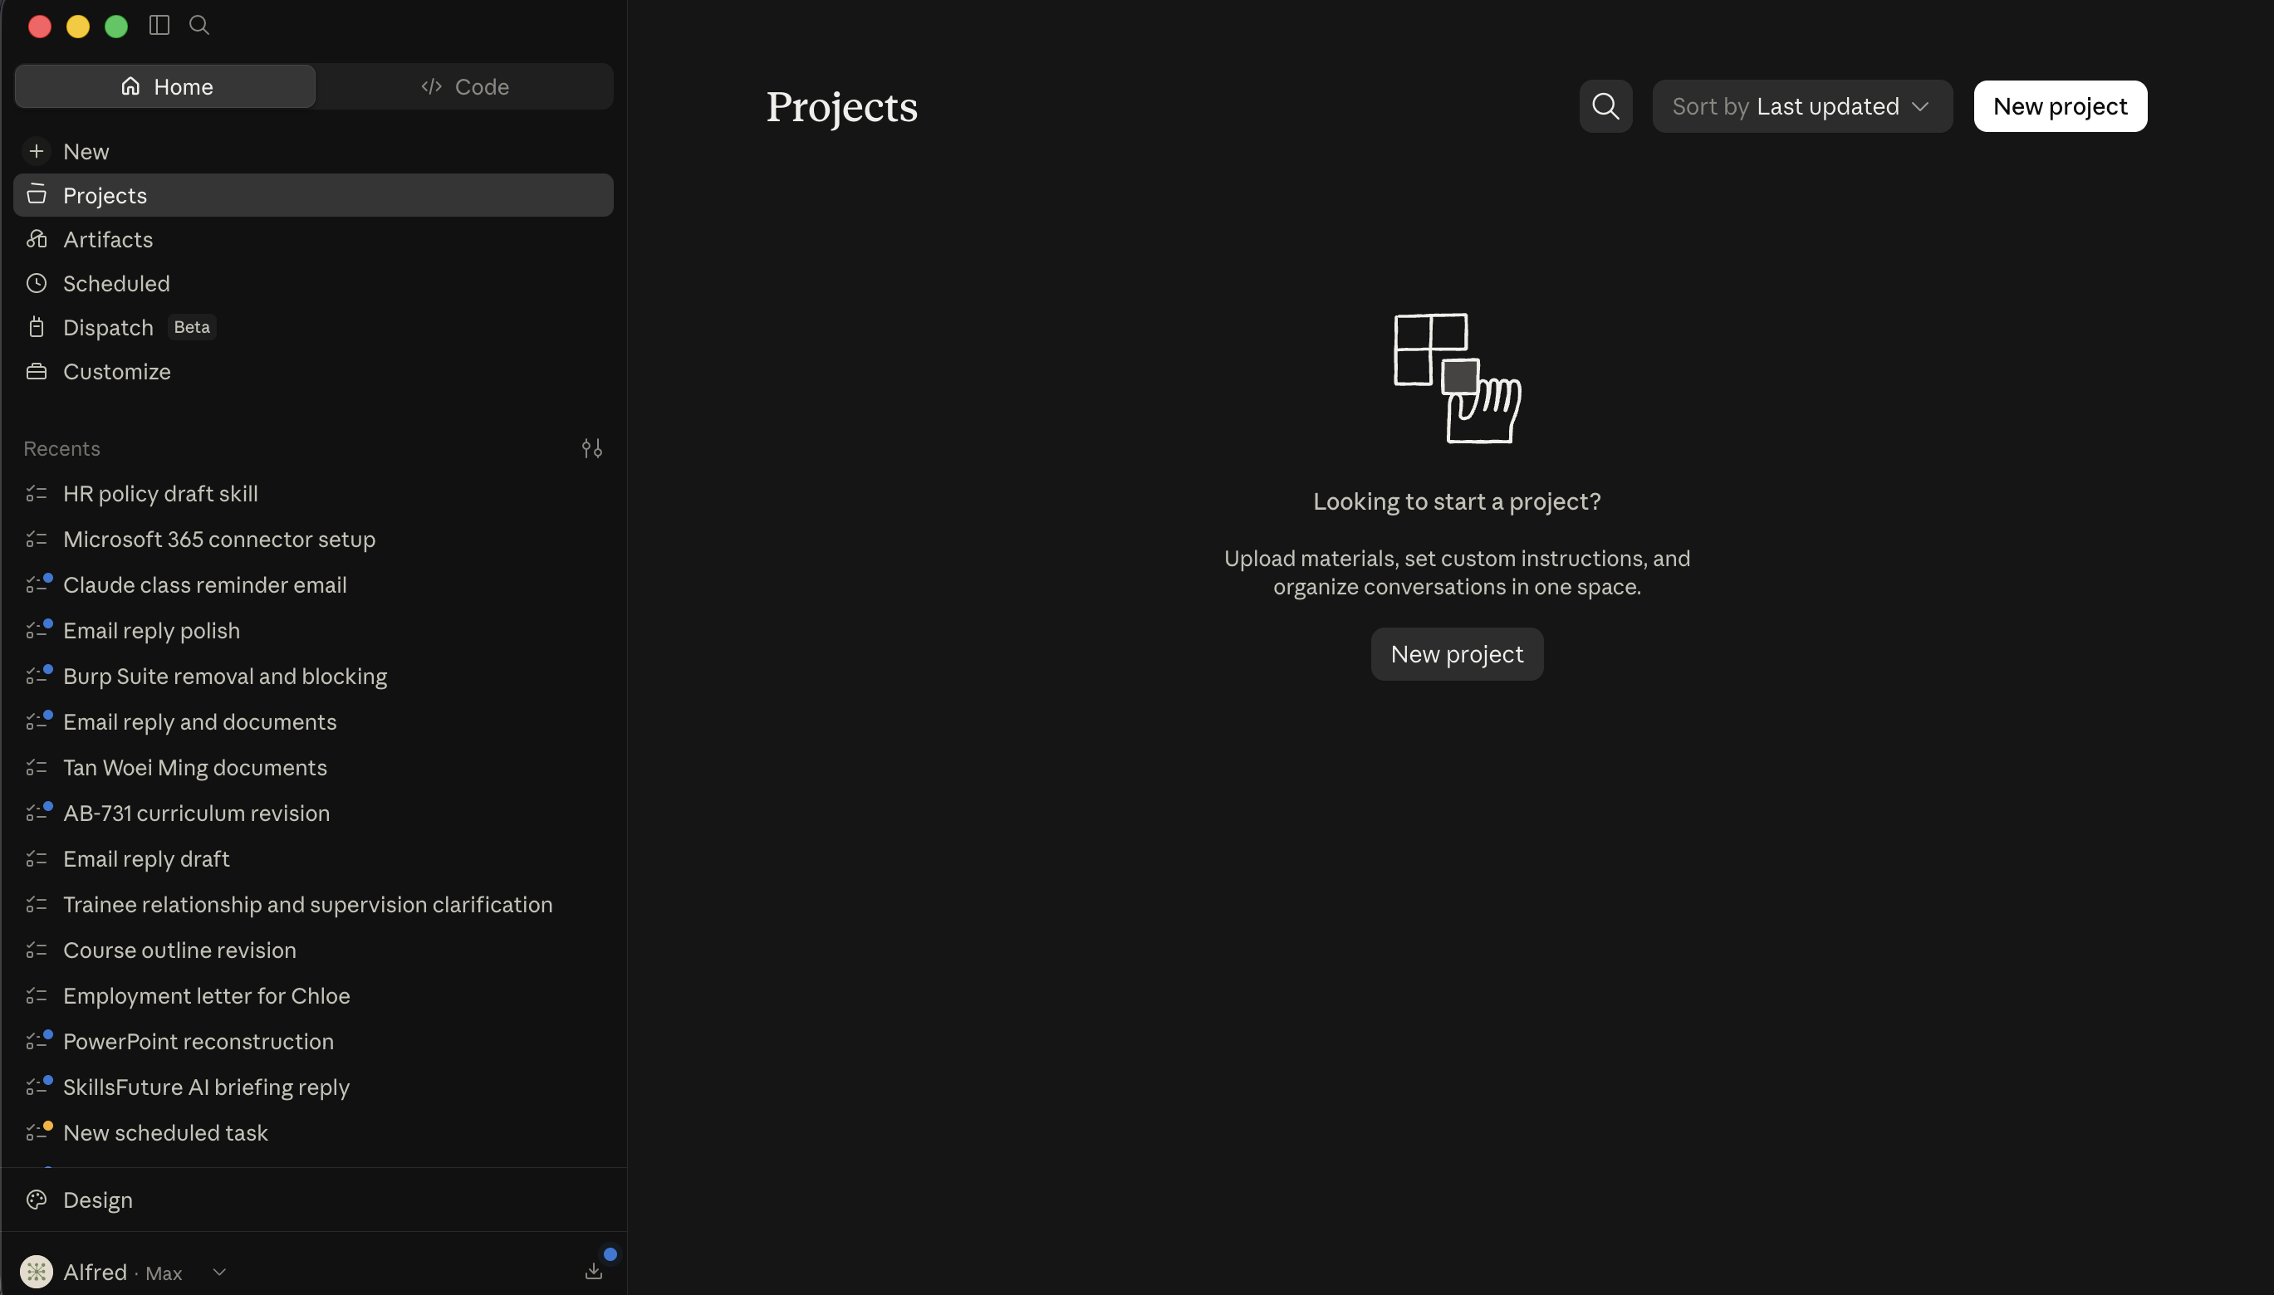
LAB 12 · SCREENSHOT
Projects
Claude Desktop > Projects > New project. Upload the HR materials once and set standing instructions, so every conversation in the project starts with the same context.
Claude Microsoft 365 Masterclass (C197) · C197
© 2026 Tertiary Infotech Academy Pte Ltd
91

Slide 93
CONCEPT-TO-OUTCOME
Lab 12 — Process Map
1
2
3
4
5
▶
▶
▶
▶
Create the project
Upload the materials
Set the standing rules
Run the pipeline
Run it again in one line
Claude Microsoft 365 Masterclass (C197) · C197
© 2026 Tertiary Infotech Academy Pte Ltd
92

Slide 94
KEY DECISIONS & CONTROLS
Lab 12 — Professional Practice
A project holds context
Materials and instructions live in the workspace, not in each prompt.
Skills carry the how
A skill is a method; a project is the material that method works on.
1
2
Set the rules once
The standing instructions apply to every conversation in the project.
Repeatable, not automatic
The pipeline repeats itself; a person still reads what comes out.
3
4
Claude Microsoft 365 Masterclass (C197) · C197
© 2026 Tertiary Infotech Academy Pte Ltd
93

Slide 95
LAB 12 · VERIFY
Automate an HR Pipeline with a Project
✅ ACCEPTANCE CHECK
A project named Lumina Living HR exists with the policy PDFs, the staff workbook and the quarter files uploaded, and custom instructions set. The new starter pipeline produced a checklist with owners, a welcome note and a report line for two different starters, every fact naming its source file, with gaps marked 'need to check'.
INSPECT
RECONCILE
ENDORSE
Open the native artifact and challenge its sources, formulas, structure and versions.
Confirm every material figure or claim against the approved evidence location.
Record the named reviewer before accepting, saving, releasing or sending the work.
Claude Microsoft 365 Masterclass (C197) · C197
© 2026 Tertiary Infotech Academy Pte Ltd
94

Slide 96
TOPIC 04 · HANDS-ON
Draft an Outlook Reply with Claude in Chrome
LAB 10
Claude in Chrome works on the page in front of you. Open a staff message in Outlook web, have Claude draft the reply into the real compose box, check it, and decide whether it goes.
You'll build
A reviewed reply drafted in Outlook on the web, sent only after you approved it or deliberately left in Drafts.
Tools: Claude for Chrome, Outlook on the web, per-action approval
Claude Microsoft 365 Masterclass (C197) · C197
© 2026 Tertiary Infotech Academy Pte Ltd
95

Slide 97
CONCEPT-TO-OUTCOME
Lab 10 — Process Map
1
2
3
4
5
▶
▶
▶
▶
Open Outlook in Chrome
Open the message
Claude drafts into the reply box
Check it in Outlook
You press Send
Claude Microsoft 365 Masterclass (C197) · C197
© 2026 Tertiary Infotech Academy Pte Ltd
96

Slide 98
KEY DECISIONS & CONTROLS
Lab 10 — Professional Practice
Chrome sees the page
Claude in Chrome works on whatever is open in the browser, so the message must be on screen.
Approve each action
Manually approve means Claude asks before it touches the page. Never turn that off.
1
2
The draft is real
It lands in the Outlook compose box, not in a chat window.
Sending stays yours
Claude drafts. A person reads it and presses Send.
3
4
Claude Microsoft 365 Masterclass (C197) · C197
© 2026 Tertiary Infotech Academy Pte Ltd
97

Slide 99
LAB 10 · VERIFY
Draft an Outlook Reply with Claude in Chrome
✅ ACCEPTANCE CHECK
A reply was drafted into the Outlook compose box, the recipient and every fact were checked, anything unsupported is marked 'need to check', and the message was either sent after approval or deliberately left in Drafts. Permission mode stayed on Manually approve throughout.
INSPECT
RECONCILE
ENDORSE
Open the native artifact and challenge its sources, formulas, structure and versions.
Confirm every material figure or claim against the approved evidence location.
Record the named reviewer before accepting, saving, releasing or sending the work.
Claude Microsoft 365 Masterclass (C197) · C197
© 2026 Tertiary Infotech Academy Pte Ltd
98

Slide 100
TOPIC 04 · HANDS-ON
Add Skills and Connectors to the Project
LAB 13
The project holds the materials and the rules. Add the hr-policy-draft skill so it knows your method, and the Microsoft 365 connector so it can reach real files and mail. Then run the full HR workflow end to end.
You'll build
An HR project with materials, standing rules, a skill and a connector, running one request that produces a policy draft, a summary and an Outlook draft.
Tools: Claude Projects, Claude Skills, Microsoft 365 connector, Cowork
Claude Microsoft 365 Masterclass (C197) · C197
© 2026 Tertiary Infotech Academy Pte Ltd
99

Slide 101
CONCEPT-TO-OUTCOME
Lab 13 — Process Map
1
2
3
4
5
▶
▶
▶
▶
Materials and rules
Add the skill
Add the connector
Run the whole workflow
Decide what stays automatic
Claude Microsoft 365 Masterclass (C197) · C197
© 2026 Tertiary Infotech Academy Pte Ltd
100

Slide 102
KEY DECISIONS & CONTROLS
Lab 13 — Professional Practice
Three things, one workspace
Materials say what to work on, the skill says how, the connector says where else to look.
One request, many steps
The project can draft, summarise and prepare mail without you moving between apps.
1
2
More reach, more care
A connector reads real company content, so the read-only boundary matters more, not less.
Automatic is a choice
Decide deliberately which steps may run unattended and which always need a person.
3
4
Claude Microsoft 365 Masterclass (C197) · C197
© 2026 Tertiary Infotech Academy Pte Ltd
101

Slide 103
LAB 13 · VERIFY
Add Skills and Connectors to the Project
✅ ACCEPTANCE CHECK
The project has the hr-policy-draft skill enabled and the connector state recorded. One request produced a policy draft following the skill's rules, a headcount summary naming its source files, and an unsent Outlook draft. Nothing was sent, and you have written which steps may run unattended and which always need a person.
INSPECT
RECONCILE
ENDORSE
Open the native artifact and challenge its sources, formulas, structure and versions.
Confirm every material figure or claim against the approved evidence location.
Record the named reviewer before accepting, saving, releasing or sending the work.
Claude Microsoft 365 Masterclass (C197) · C197
© 2026 Tertiary Infotech Academy Pte Ltd
102

Slide 104
TOPIC 04 · HANDS-ON
Upload a Shared Skill for Slides
LAB 14
Your company has a house standard for decks, written once and shared as a file. Upload it as a skill and apply it to a weak draft deck.
You'll build
An uploaded deck-design-standard skill, and a rebuilt deck where every title states a conclusion.
Tools: Claude Skills, Claude for PowerPoint, Upload a skill
Claude Microsoft 365 Masterclass (C197) · C197
© 2026 Tertiary Infotech Academy Pte Ltd
103

Slide 105
CONCEPT-TO-OUTCOME
Lab 14 — Process Map
1
2
3
4
5
▶
▶
▶
▶
A standard written once
Upload it
Apply it to a weak deck
Compare with your own version
Choose the right method
Claude Microsoft 365 Masterclass (C197) · C197
© 2026 Tertiary Infotech Academy Pte Ltd
104

Slide 106
KEY DECISIONS & CONTROLS
Lab 14 — Professional Practice
Upload a skill
Use this when the standard already exists and the team should share it.
One house standard
Everyone's deck looks like the company wrote it.
1
2
Read before you upload
A shared skill applies someone else's rules to your work.
Three ways to create
Write it, have Claude create it, or upload one someone else wrote.
3
4
Claude Microsoft 365 Masterclass (C197) · C197
© 2026 Tertiary Infotech Academy Pte Ltd
105

Slide 107
LAB 14 · VERIFY
Upload a Shared Skill for Slides
✅ ACCEPTANCE CHECK
The deck-design-standard skill was uploaded from the supplied file, running it changed every slide title to a conclusion and added source notes, the slide master is unchanged, and slide 1's speaker notes say which of the ways of creating a skill you would use and why.
INSPECT
RECONCILE
ENDORSE
Open the native artifact and challenge its sources, formulas, structure and versions.
Confirm every material figure or claim against the approved evidence location.
Record the named reviewer before accepting, saving, releasing or sending the work.
Claude Microsoft 365 Masterclass (C197) · C197
© 2026 Tertiary Infotech Academy Pte Ltd
106

Slide 108
TOPIC RECAP
Recap — Staff Questions, Repeatable Work and Advanced Claude
Capability — Invoke a saved skill from Word so it reads the Excel workbook and writes the figures into the document.
Evidence retained — A completed quarterly update with figures drawn from the workbook, saved as a final copy.
1
2
Capability — Sort a set of staff messages by what each one needs, and draft one reply for approval.
Evidence retained — Every message sorted, one reply drafted, the person who would approve it named, and the reply created as an Outlook draft ready for review.
3
4
Capability — Have Claude read across a folder of HR files and write one summary, reporting what the files disagree on rather than resolving it.
Evidence retained — A two-page people summary built only from the folder, naming the file behind every claim, with disagreements reported rather than settled.
5
6
Claude Microsoft 365 Masterclass (C197) · C197
© 2026 Tertiary Infotech Academy Pte Ltd
107

Slide 109
WRAP-UP
Course Summary & Next Steps
Claude Microsoft 365 Masterclass (C197) · C197
© 2026 Tertiary Infotech Academy Pte Ltd
108

Slide 110
LEARNING OUTCOMES
What You Achieved
Pick the right place
Choose the right place to use Claude for an HR task.
Decide what Claude reads
Decide what staff information Claude may read, and what it must never change.
1
2
Ask clearly
Write a request that says what you want, what to use, what to leave alone and when to stop.
Plan the hiring
Write a hiring plan in Word using only what the brief actually says.
3
4
Check the policy wording
Draft leave and flexible-work policy wording that flags every point needing legal review.
5
Claude Microsoft 365 Masterclass (C197) · C197
© 2026 Tertiary Infotech Academy Pte Ltd
109

Slide 111
LEARNING OUTCOMES
What You Achieved (cont.)
People numbers
Build a headcount and turnover analysis in Excel using live formulas.
Tell leadership
Build a leadership update deck where every slide title states a conclusion.
6
7
Handle the inbox
Sort the HR inbox and draft one reply ready for approval.
One folder, one summary
Have Claude read one folder and write a people summary that says where each fact came from.
8
9
Automate the update
Automate a weekly people update on your own computer.
10
Claude Microsoft 365 Masterclass (C197) · C197
© 2026 Tertiary Infotech Academy Pte Ltd
110

Slide 112
LEARNING OUTCOMES
What You Achieved (cont.)
Save it as a Skill
Save a working method as a Skill so the whole team applies the same standard.
Connect SharePoint
Use the Microsoft 365 connector to find HR files stored in SharePoint.
11
12
Add a plugin
Add a plugin, and judge when a task needs one and when it does not.
13
Claude Microsoft 365 Masterclass (C197) · C197
© 2026 Tertiary Infotech Academy Pte Ltd
111

Slide 113
WRAP-UP
Keep Practising After the Course
Re-run the labs on your own machine — repetition is what makes the skills stick.
Apply the techniques to a real process or project in your own organisation.
1
2
Your course material stays available at https://lms-tms.tertiaryinfotech.com/.
Explore the follow-on courses at www.tertiarycourses.com.sg.
3
4
Claude Microsoft 365 Masterclass (C197) · C197
© 2026 Tertiary Infotech Academy Pte Ltd
112

Slide 114
CURRENT PRODUCT GUIDANCE
Selected References & Further Learning
Claude for Microsoft 365 overview
claude.com
Claude for Microsoft 365 add-ins overview
claude.com
1
2
Use Claude for Word
claude.com
Use Claude for Outlook
claude.com
3
4
Get started with Claude in Chrome
support.claude.com
Claude in Chrome permissions guide
support.claude.com
5
6
Claude Microsoft 365 Masterclass (C197) · C197
© 2026 Tertiary Infotech Academy Pte Ltd
113

Slide 115
COURSE CLOSE
Thank You — Keep the Workflow Governed
Carry one connected evidence chain from source to decision.
1
2
3
BUILD
VERIFY
APPROVE
Create useful native Word, Excel and PowerPoint work products.
Trace claims, formulas, charts, recipients and assumptions to evidence.
Keep final save, release and send decisions with the authorised human.
Claude Microsoft 365 Masterclass (C197) · C197
© 2026 Tertiary Infotech Academy Pte Ltd
114

